Slide 1
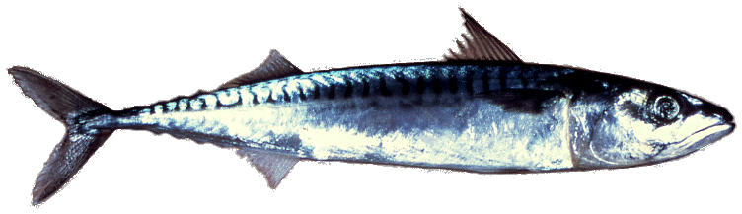
2023 Atlantic mackerel management track assessment Kiersten Curti NEFSC, Stock assessment lead Sept 2023
Northeast Fisheries Science Center

Slide 2
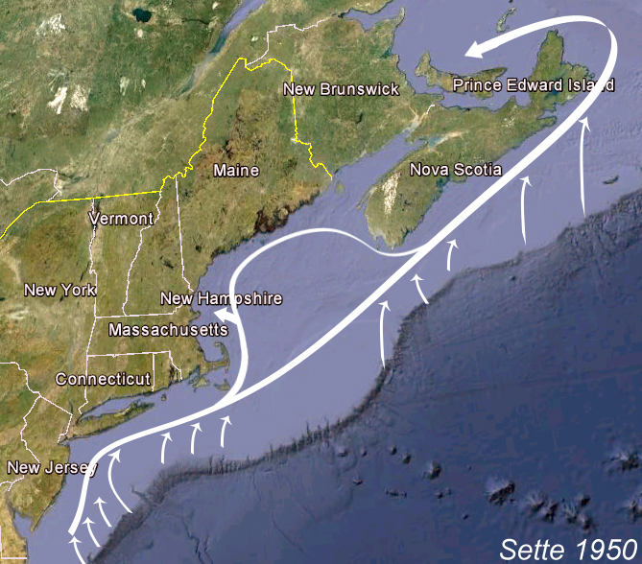
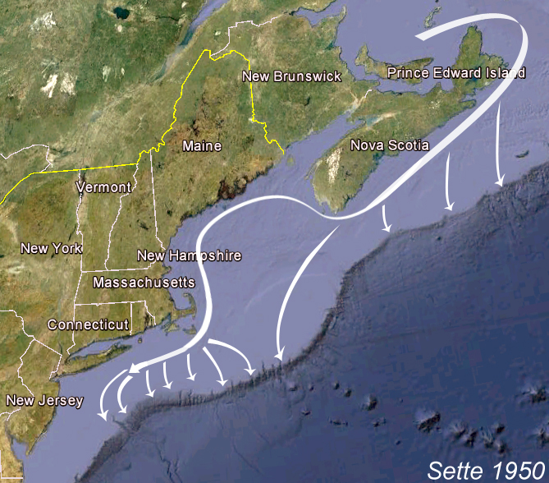
NW Atlantic mackerel seasonal migration patterns
(Sette 1950)
Spring Migration
Fall Migration

Slide 3
Background
Last assessed and reviewed in July 2021 (2019 terminal year)
Primary assessment model = ASAP
Ages 1-10⁺; Constant M = 0.2
One fishing fleet, time-invariant flat-topped selectivity (age 6⁺ = 1)
Three fishery-independent surveys
Range-wide SSB index from egg surveys
Spring bottom trawl survey (ages 3⁺, dome-shaped selectivity)
Albatross years (1974-2008)
Bigelow years (2009⁺ )
Long-term projections based on empirical CDF derived using recruitment estimates from 1975 onward
BRPs: F40% as Fmsy proxy (0.22)
Resulting stock status: overfished (24% of SSB msy proxy) with overfishing occurring (208% of Fmsy proxy)
Frebuild = 0.12 (F to rebuild stock by 2032, assuming two-stanza recruitment)

Slide 4
Term of Reference 1:
Estimate catch from all sources, including landings and discards
(Canada updated all input data for 2023 assessment)

Slide 5
Total catch (thousands mt)
Reported Canadian catches represent a subset of total Canadian catch because the bait fishery, recreational fishery and commercial discards are not monitored.
Canadian directed commercial and bait fisheries closed in 2022
Notes:
2011-2021: Total catch averaged a little under 17,000 mt
2022: Total catch = ~ 3600 mt; Due to closure of Canadian fishery, reduced US commercial catch (<2200mt) and slightly lower US rec catch (1440 mt where median was 2400 since 2010)
M:\Kiersten_Curti\Fishery-dependent.data\Total.catch\1968-2022\Summary.Figures\Total.catch.thous.mt.wmf

Slide 6
U.S. catch (thousands mt)
Notes:
Discards 2020-2022 = 1.5% of total US catch
Rec = 37% of total catch since 2010
M:\Kiersten_Curti\Fishery-dependent.data\Total.catch\1968-2022\Summary.Figures\US.Total.catch.thous.mt.wmf

Slide 7
Discards estimates comparison
 | Combined ratio |  | CAMS
 | Estimate (mt) | CV | Estimate (mt) | CV
2018 | 177 | 0.23 | 218 | 0.18
2019 | 200 | 0.38 | 215 | 0.28
Notes:
Estimates from CAMS within one stdev of combined ratio estimates

Slide 8
Total catch-at-age (U.S. plus Canada)
Notes:
M:\Kiersten_Curti\Fishery-dependent.data\Total.catch\1968-2022\Summary.Figures\Combined.US.Can.Catch.at.age.millions.wmf

Slide 9
Term of Reference 2:
Evaluate indices used in the assessment
(Canada updated all input data for 2023 assessment)

Slide 10
NEFSC spring survey: Albatross years
Notes:
P:\Mackerel\Fishery-independent.data\NEFSC.Bottom.Trawl.Survey\ADIOS.Outputs\Through2019\Figures
alb.1968.numb.wt.tow.3plus.wmf
alb.1968.CAA.3plus.wmf

Slide 11
NEFSC spring survey: Bigelow years
Notes:
M:\Kiersten_Curti\Fishery-independent.data\NEFSC.Bottom.Trawl.Survey\ADIOS.Outputs\Through2022\Figures
big.2009.numb.wt.tow.3plus.wmf
big.2009.CAA.3plus.wmf

Slide 12
Combined range-wide SSB index (egg and ecosystem surveys)
Notes:
Time series minimum in 2010 and below the time-series median since 2009
Generally increased through 2018, but declined to within 10% of 2010 value by 2022
M:\Kiersten_Curti\Fishery-independent.data\Combined.US.Can.Egg.Index\Through2022\Combined.SSB.mill.mt.Egg.Index.wmf

Slide 13
Contribution of the southern spawning contingent
Notes:
Egg production of the southern contingent has been ~ an order of magnitude greater since 2018 compared to the previous decade.
Since 2018, the southern contingent has represented between 10-50% of the rangewide SSB
M:\Kiersten_Curti\Fishery-independent.data\Combined.US.Can.Egg.Index\Through2022\US.SSB.Proportion.Egg.Index.wmf

Slide 14
Term of Reference 3:
Estimate annual fishing mortality, recruitment and stock biomass for the time series using the approved assessment method and estimate their uncertainty. Include retrospective analyses if possible (both historical and within-model) to allow a comparison with previous assessment results and projections, and to examine model fit.
Include bridge runs from the previously accepted model to the updated model proposed for this peer review.

Slide 15
Bridge runs:
2) 2020-2022
3) Maturity
4) WAA
Notes:
Runs 2-4: Peak in 1972 went from 1.13 mill to 1.24 mil

Slide 16
Bridge runs:
5) Fishery catch
6) Egg index
Notes:
Runs 4-6: 1972 peak went from 1.24 mill to 1.19 mill
Late 1970s-early 1980s dip – reduced by about 1/3
Reduction in F in 2010s

Slide 17
Bridge runs:
7) Trawl survey
9) Increase egg
index CV

Slide 18
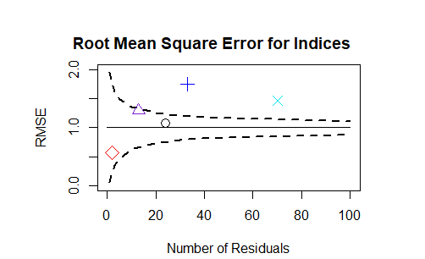
ASAP diagnostics: Index RMSEs
Notes:
The annual CVs for the egg survey index were increased by 0.3 to reduce the retrospective pattern and to reduce the root mean square error to within the confidence bounds associated with a N(0,1) distribution for the index sample size
C:\Users\Kiersten.Curti\Desktop\Work\Mackerel\2023.Management.Track\Run9\plots
RMSE.95CI.Indices.png

Slide 19
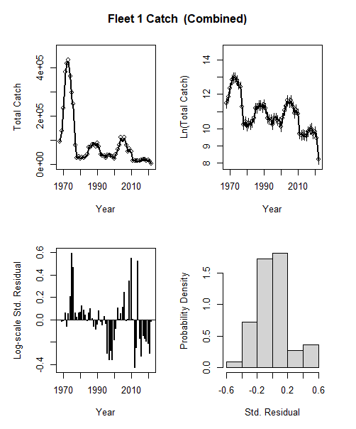
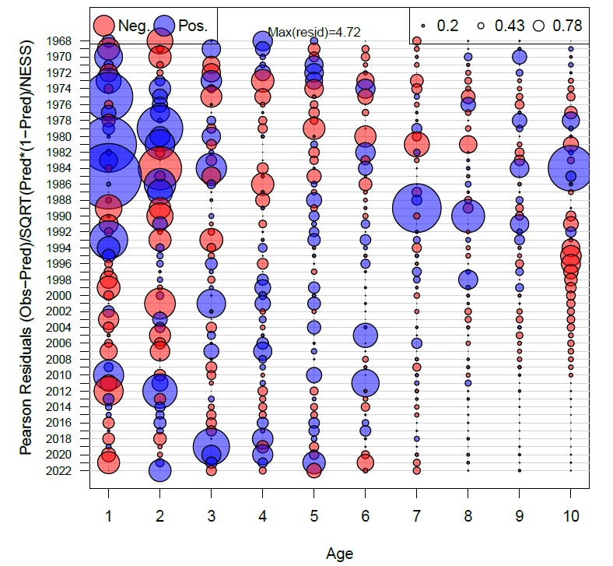
ASAP diagnostics: Fit to fishery catch
Notes:
C:\Users\Kiersten.Curti\Desktop\Work\Mackerel\2023.Management.Track\Run9\plots
Catch.4panel.1.png
Took snapshot of age comps from pdf because looked better than Pearson.catch.resid.bubble.plots.1.png

Slide 20
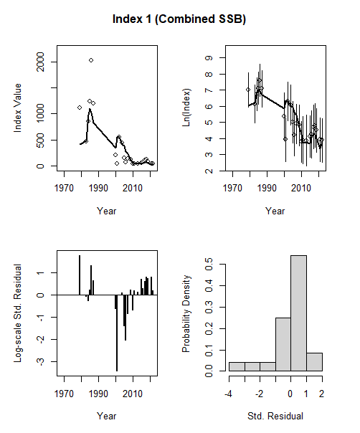
ASAP diagnostics: Fit to range-wide SSB index
Notes:
C:\Users\Kiersten.Curti\Desktop\Work\Mackerel\2023.Management.Track\Run9\plots
Index.4panel.1.png

Slide 21
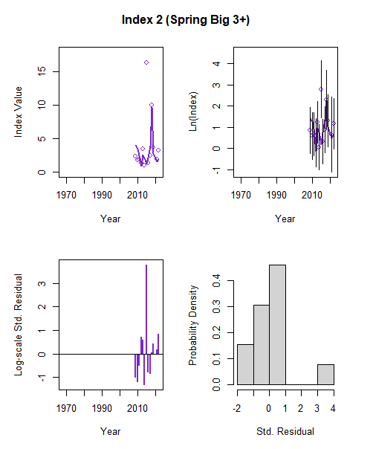
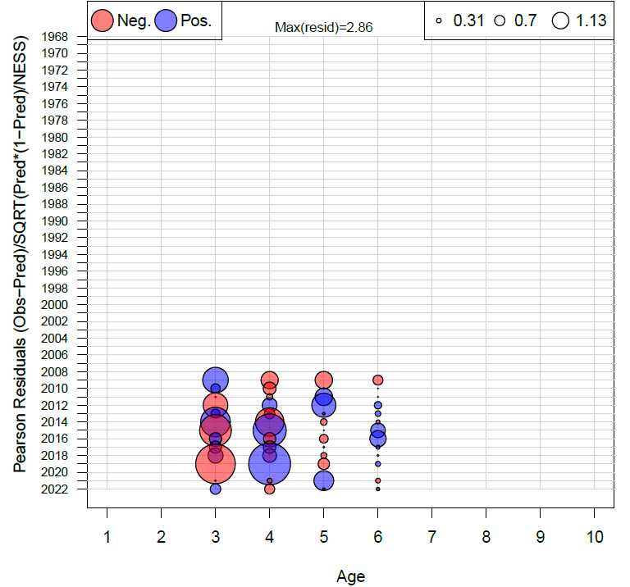
ASAP diagnostics: Fit to Bigelow index (2009-2022)
Notes:
C:\Users\Kiersten.Curti\Desktop\Work\Mackerel\2023.Management.Track\Run9\plots
Index.4panel.2.png
Index.4panel.2.wmf

Slide 22
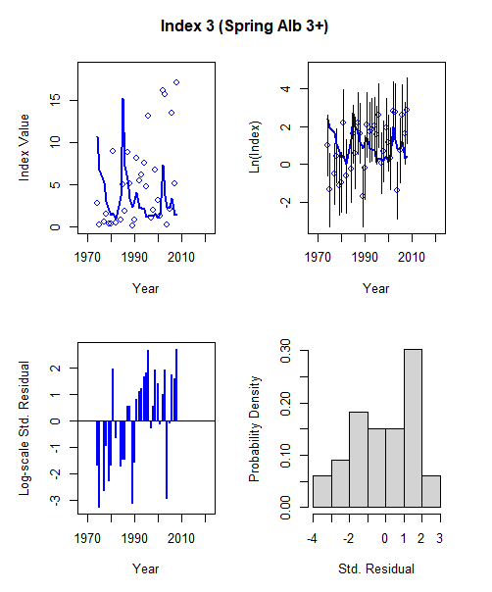
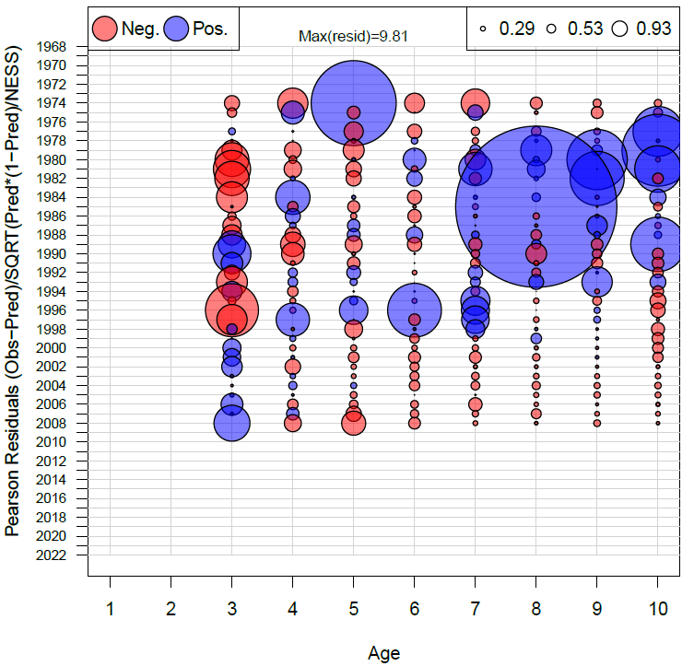
ASAP diagnostics: Fit to Albatross index (1968-2008)
Notes:
C:\Users\Kiersten.Curti\Desktop\Work\Mackerel\2023.Management.Track\Run9\plots
Index.4panel.3.png
Index.4panel.3.wmf

Slide 23
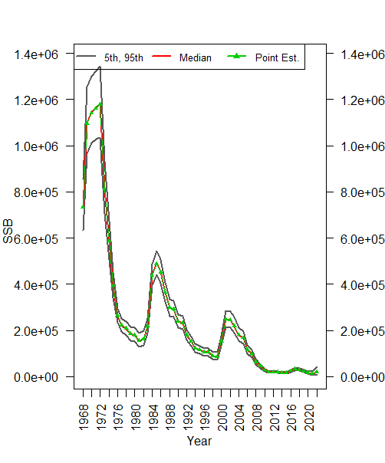
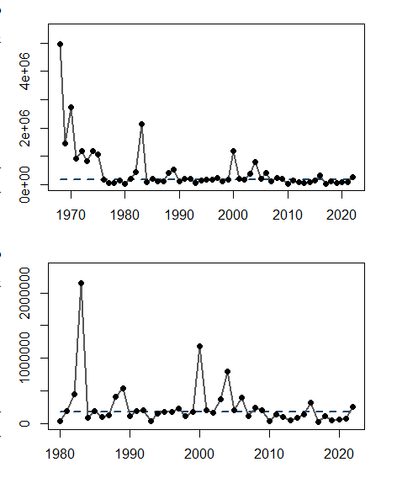
ASAP estimates:
Spawning stock biomass (mt)
Recruitment (000s)
Notes:
SSB = Thought we reached a minimum in 2014 but minimum in 2021 of 12,300 mt
2022 = 19K
Rect:
With exception of 2015 and 2021 year classes, recruitment has been below the time-series median since 2009
2016 YC was the smallest of the time series.
While Rect has been below the time-series median, mackerel condition has been comparatively high since 2013 for mature mackerel and 2011 for immature mackerel
Change-point analysis: 1969-1970, 1971-1975, 1976-2022
M:\Kiersten_Curti\Modeling\2023.Management.Track\Run9\mcmc.2000.it.1000.thin\plots
SSB.90PI.png
Recruitment figure is created from code at end of Complete.ASAP.Plots.R and copy/pasted directly from TR

Slide 24
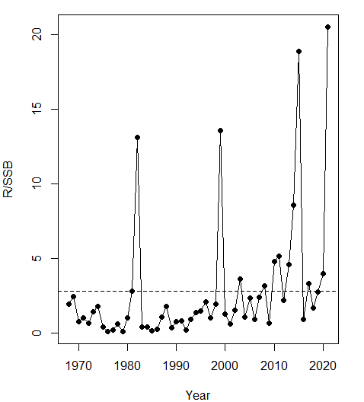
ASAP estimates:
R/SSB
Notes:
R/S: Change-point analysis: 1969-2010, 2011-2021, 2022;
If add 4th stanza, 1969-2015, 2016-2018, 2019-2021, 2022
M:\Kiersten_Curti\Modeling\2023.Management.Track\Run9\plots
RpSSB_time_series.png

Slide 25
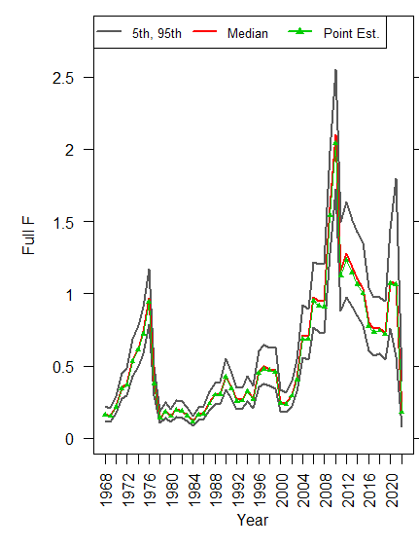
ASAP estimates:
Fishing mortality
Notes:
Maximum of 2.04 in 2010; Generally decreased in the 2010s but increased to 1.07 in 2020-2021 before Canada closed their fishery in 2022 (0.18)
M:\Kiersten_Curti\Modeling\2023.Management.Track\Run9\mcmc.2000.it.1000.thin\plots
Full.F.90PI.png

Slide 26
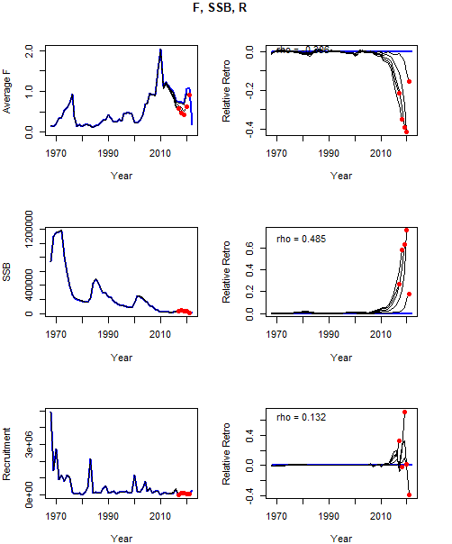
Retrospective
analysis:
5 year peels
2017-2021
ρ= -0.306
ρ=0.485
2021 MT
Mohns ρ estimates:
F = -0.093
SSB = 0.326
Rect = 0.431
ρ=0.132
Notes:
M:\Kiersten_Curti\Modeling\2023.Management.Track\Run9\retro\plots
retro_F_SSB_R.png
M:\Kiersten_Curti\Modeling\2023.Management.Track\Run9\outputs\Run9. Retrospective.Analysis.RDATA

Slide 27
Retrospective analysis:
Terminal year estimates with 90% CIs
rho-adjusted
original
Notes:
C:\Users\Kiersten.Curti\Desktop\Work\Mackerel\2023.Management.Track\Run9\outputs
Terminal.yr.and.Retro.adj.values.with.CIs.wmf

Slide 28
Natural mortality
Notes:
M:\Kiersten_Curti\Modeling\2023.Management.Track\Run9.Mprofile
Subset.Likelihood.difference.profile.wmf

Slide 29
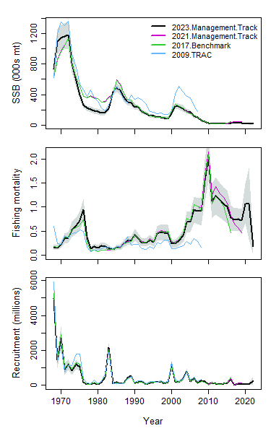
Historical retrospective
* 2009 TRAC did not pass peer review
Notes:
M:\Kiersten_Curti\Modeling\2023.Management.Track\Run9\outputs
Historical.retrospective.fyr.1968.png

Slide 30
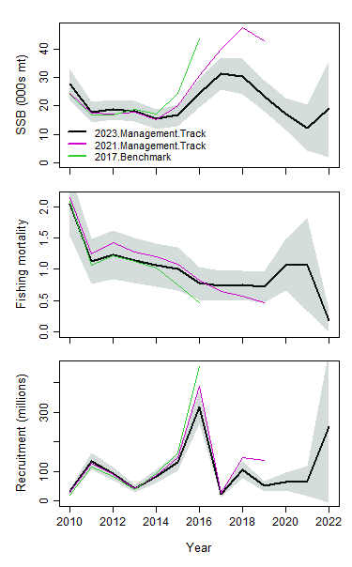
Historical retrospective
Notes:
M:\Kiersten_Curti\Modeling\2023.Management.Track\Run9\outputs
Historical.retrospective.fyr.2010.png

Slide 31
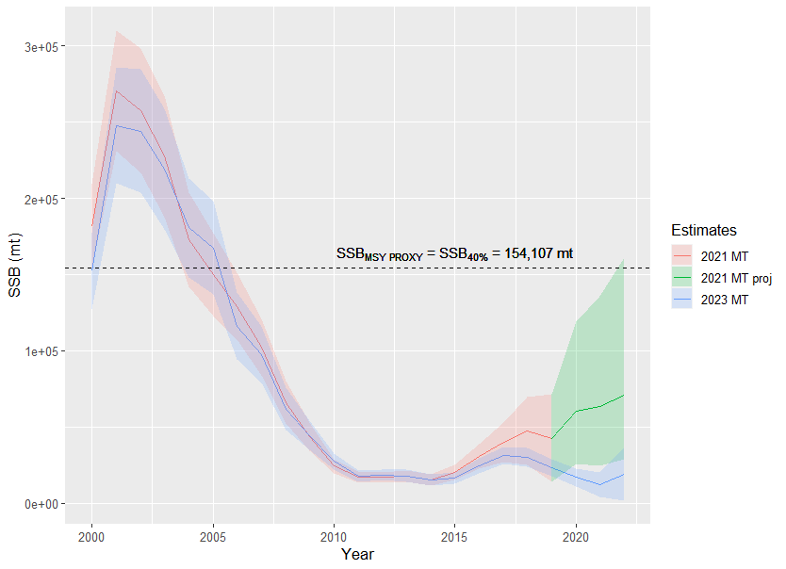
Comparison with 2021 MT projections
ASAP estimates:
2021 MT
2023 MT
Projections:
2021 MT
(Frebuild, 0.12)
Notes:
C:\Users\Kiersten.Curti\Desktop\Work\Mackerel\2023.Management.Track\Run9\projections.rebuilding\F11
SSB.ests.fyr.2000.with.historical.sub.wmf

Slide 32
2021 MT comparison with 2017 benchmark projections
ASAP estimates:
2017 Benchmark
2021 MT
Projections:
2017 Benchmark
(Frebuild, 0.237)
2021 MT
(Fmsy, 0.22)
Notes:
P:\Mackerel\Modeling\2021.Management.Track\Run4\projections.2year
SSB.projections.Fmsy.proxy.fyr.2000.with.historical.wmf

Slide 33
Term of Reference 4:
Re-estimate or updated the BRP’s as defined by the management track level and recommend stock status. Provide qualitative descriptions of stock status based on simple indicators/metrics.

Slide 34
Biological reference points
 | 2021 MT | 2023 MT
F_{MSY proxy} | 0.22 | 0.21
SSB_{MSY proxy} | 181,090 | 154,107 | (86,490-332,677)
B_{MSY proxy} | 237,989 | 209,952 | (118,636-432,417)
MSY proxy | 34,103 | 30,460 | (17,321-63,448)

Slide 35
Recommended stock status
2022 estimates:
F: 0.18
(0.003-0.35)
SSB: 19,017 mt
(1,835-36,199)
Overfished (12% of SSB msy proxy) but overfishing not occurring (86% of Fmsy proxy)
→ Change in overfishing status
Notes:
M:\Kiersten_Curti\Modeling\2023.Management.Track\Run9\outputs
Phase.plot.with.cis.wmf
Run9.Terminal.yr.estimates.with.CIs.csv

Slide 36
Qualitative stock status metrics
Age truncation apparent in fishery catches
Age-9 fish were observed in 2019-2021 fishery catches for the first time since 2012
Range-wide SSB estimates from egg surveys have been below the time-series median since 2009
Southern contingent egg production has been an order of magnitude greater in since 2018 compared to the previous decade
With the exception of the 2015 and 2021 year classes, recruitment estimates have been below the time-series median since 2009
2016 year class was the smallest estimate of the time series

Slide 37
2023 Canadian assessment of the northern contingent
DFO revised the full suite of input data for the 2023 assessment (CAA, WAA, egg index, maturity, fecundity)
SSB has been in or near the critical zone since 2011
After reaching a time-series minimum in 2021, 2022 SSB was estimated to be 17,649 mt and 42% of the LRP (40% of SSB_{40%})
Fully selected fishing mortality was estimated to be 0.42 in 2022 and was below F40% for the first time since 1997
Estimated recruitment (2012 onward) has been below the time-series median since 2009 and 2022 represented the 3rd lowest estimate of the time series
Notes:
Critical zone (below LRP)

Slide 38
Term of Reference 5:
Conduct short-term projections

Slide 39
Short-term projections
Following methodology of rebuilding plan, recruitment sampled from empirical CDFs derived assuming two recruitment stanzas
When SSB < ½ SSB_{MSY}, CDF based on estimates from 2009 onward
When SSB ≥ ½ SSB_{MSY}, CDF based on estimates from 1975 onward
2023 catch assumption: 5,953 mt (2023 US ACL + 2022 Canadian catch)
F_{rebuild} defined as the F that would result in a 61% probability of rebuilding the stock by 2032 (F_{rebuild} updated from 0.12 to 0.11 with this MT)
Sensitivity analyses per request of MAFMC staff due to poor projection performance
2022 recruitment estimate reduced to median of recent recruitment (2009 onward) (F_{rebuild} reduced from 0.11 to 0.07)
Retrospective adjustments made to terminal year NAA estimates
2022 recruitment estimate reduced to median of recent recruitment; retrospective adjustments made to NAA estimates for all other ages

Slide 40
 | Base | Reduced 2022 Rect
2023 | 43,721 | 26,387
2024 | 69,870 | 42,756
2025 | 85,584 | 61,060
2026 | 96,586 | 75,584
2027 | 109,397 | 88,050
2028 | 121,447 | 101,857
2029 | 135,534 | 117,098
2030 | 151,543 | 135,003
2031 | 163,892 | 153,837
2032 | 175,493 | 172,040
Projections at Frebuild: SSB
Notes:
C:\Users\Kiersten.Curti\Desktop\Work\Mackerel\2023.Management.Track\Run9\projections.rebuilding
ssb.projections.fyr.2010.wmf

Slide 41
 | Base | Reduced 2022 Rect
2023 | 5,953 | 5,953
2024 | 6,864 | 2,726
2025 | 8,571 | 3,900
2026 | 9,830 | 4,866
2027 | 11,417 | 5,741
2028 | 12,710 | 6,760
2029 | 14,129 | 7,806
2030 | 15,764 | 8,976
2031 | 17,020 | 10,200
2032 | 18,197 | 11,386
Projections at Frebuild: Catch
Notes:
C:\Users\Kiersten.Curti\Desktop\Work\Mackerel\2023.Management.Track\Run9\projections.rebuilding
catch.projections.fyr.2010.wmf

Slide 42
Term of Reference 6:
Respond to any review panel comments or SSC concerns from the most recent prior assessment

Slide 43
Recommendations from 2021 MT peer review
Panel noted sources of uncertainty related to stock structure and the assumption of a constant, time invariant M
Ongoing genetics work indicates small, but potentially significant genetic differentiation between spawning contingents
Current work to develop a predation pressure index that estimates temporal trends in natural mortality due to finfish, marine mammals and gannets
Panel recommend exploration of recruitment dynamics and mechanisms that may explain patterns in recruits-per-spawner
Change-point analyses of recruitment, R/SSB and relative condition show greater support for compensation than environmentally-driven shifts

Slide 44
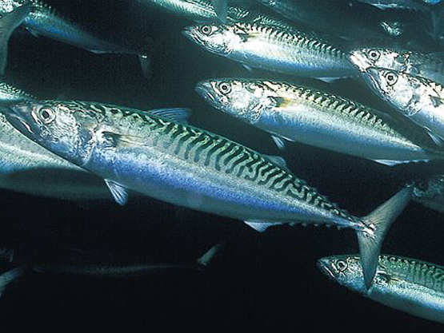
Questions?
E. Svensen

Slide 45
SSB
 | Base | Reduced 2022 Rect
2023 | 43,721 | 26,387
2024 | 69,870 | 42,756
2025 | 85,584 | 61,060
2026 | 96,586 | 75,584
2027 | 109,397 | 88,050
2028 | 121,447 | 101,857
2029 | 135,534 | 117,098
2030 | 151,543 | 135,003
2031 | 163,892 | 153,837
2032 | 175,493 | 172,040
Catch
 | Base | Reduced 2022 Rect
2023 | 5,953 | 5,953
2024 | 6,864 | 2,726
2025 | 8,571 | 3,900
2026 | 9,830 | 4,866
2027 | 11,417 | 5,741
2028 | 12,710 | 6,760
2029 | 14,129 | 7,806
2030 | 15,764 | 8,976
2031 | 17,020 | 10,200
2032 | 18,197 | 11,386
Notes:
C:\Users\Kiersten.Curti\Desktop\Work\Mackerel\2023.Management.Track\Run9\projections.rebuilding
catch.projections.fyr.2010.wmf

Slide 46
Change-point analysis of R/SSB over time
Q=4
Q=3

Slide 47
R/SSB sorted by ascending SSB
Q=3
2022
2016
2000
1983

Slide 48
Recruitment over time
Q=4
Q=3

Slide 49
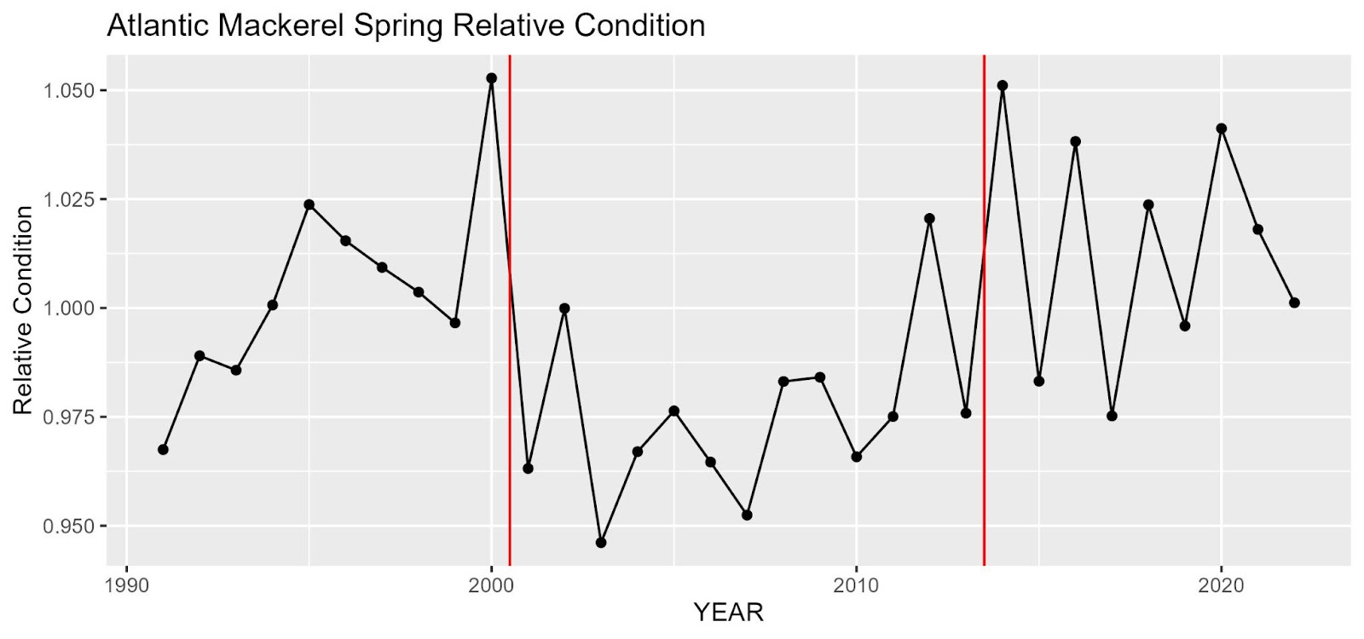
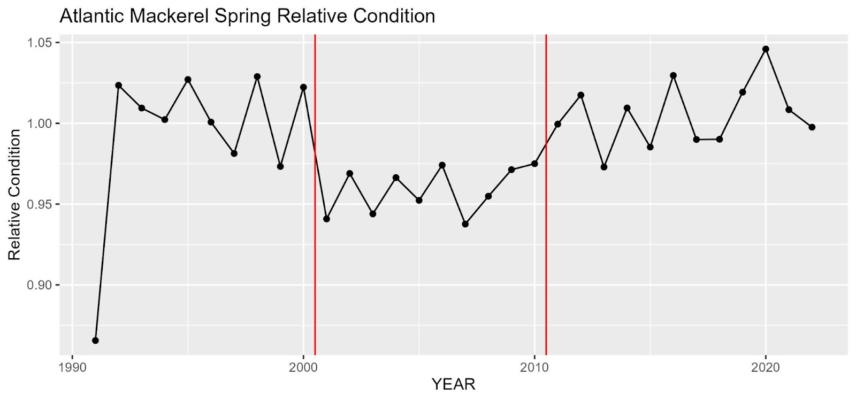
Relative condition
Mature mackerel (>23 cm)
Immature mackerel (<=23 cm)

Slide 50
Comparison with 2021 MT projections
ASAP estimates:
2021 MT
2023 MT
Projections:
2021 MT
(Frebuild, 0.12)
2023 MT
(Frebuild, 0.11)
Notes:
P:\Mackerel\Modeling\2021.Management.Track\Run4\projections.2year
SSB.projections.Fmsy.proxy.fyr.2000.with.historical.wmf

Slide 51
Maturity
Recent 5-year averages for 2023 MT and 2021 MT
Age-3 = 0.99 (0.94)
Age-2 = 0.67 (0.71)
Age-1 = 0.04 (0.18)
Notes:
M:\Kiersten_Curti\Fishery-dependent.data\DFO\1968-2022
Proportion.mature.at.age.wmf

Slide 52
SSB Weight-at-age
Notes:
M:\Kiersten_Curti\Fishery-dependent.data\Total.catch\1968-2022\Avg.Size.At.Age.Figures
Comb.US.Can.Catch.wt.age.allyrs.wmf

Slide 53
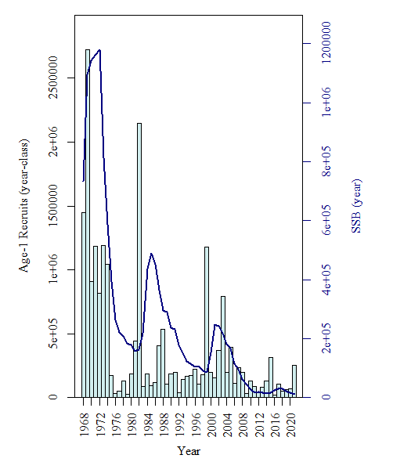
ASAP estimates:
SSB and recruitment time series
Notes:
C:\Users\Kiersten.Curti\Desktop\Work\Mackerel\2023.Management.Track\Run9\plots
SARC.SSB.vs.R.barplots.png

Slide 54
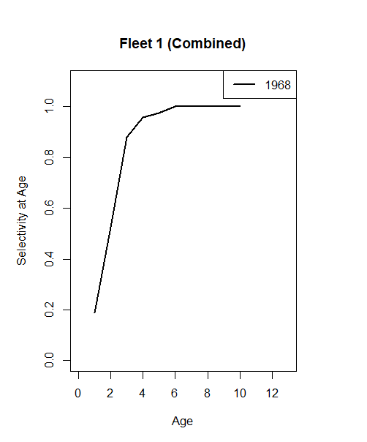
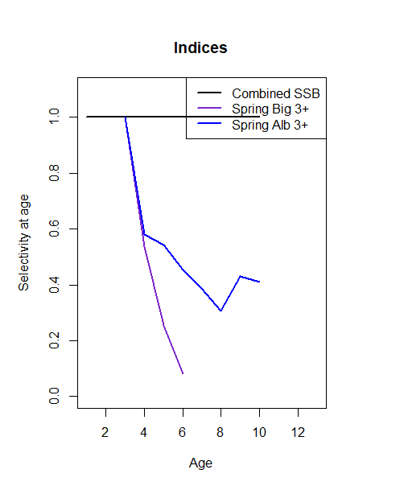
ASAP estimates: Selectivity
Notes:
C:\Users\Kiersten.Curti\Desktop\Work\Mackerel\2023.Management.Track\Run9\plots
Catch.Sel.Blocks.Fleet.1.png
Index.Sel.png

Slide 55
ASAP estimates: Terminal year estimates
Notes:
MCMC Distribution plots from GUI

Slide 56
Long-term projections
100-year projections at F_{40%} (0.21) from 2000 numbers-at-age estimates for 2023 from MCMC simulations
Recent 5-year averages used for weight-at-age and proportion mature-at-age estimates
Age-specific fishery selectivity estimates from ASAP model
Recruitment sampled from an empirical CDF derived from 1975-2019 recruitment estimates of the final ASAP model
M = 0.2

